Slide 1
Unit 1(Part-2)

Slide 2
Contents:
Classes and Objects

Slide 3
Source File Declaration Rules
There can be only one public class per source code file
If there is a public class in a file, the name of the file must match the name of the name of the public class.
A file can have more than one non public class
Files with no public classes can have a name that does not match any of the classes in the file

Slide 4

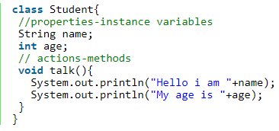

Class & Object
1. Class
A class is a group of objects which have common properties. It is a template or blueprint from which objects are created. It is a logical entity. It can't be physical.
A class in Java can contain:
variables
methods
constructors
blocks
nested class and interface

Slide 5
Class & Object
2. Object
Object is an instance of a class. An object is any thing that exists physically.
At runtime, when the JVM encounters the new keyword, it will use appropriate class to make an object which is an instance of that class.
Creating Objects for a class
Syntax: classname objname=new classname();
3. State (Instance variables)
A variable which is created inside the class but outside the method, is known as instance variable. Instance variable doesn't get memory at compile time. It gets memory at run time when object(instance) is created. That is why, it is known as instance variable.

Slide 6
Class & Object
STACK
HEAP
s
name=null
age=0
Example: Student s=new Student();
Here s variable stores the references number of the object returned by JVM after creating the object.
The new keyword is used to allocate memory at run time. All objects get memory in Heap memory area.
By using reference variable(s),we can refer instance variables and methods like s. name, s.age, s.talk()
Since we didn’t initialize instance variables, Java compiler adds some additional code to Student class name=null, age=0
When JVM executes ,preceding code .it stores null into name and 0 into age
talk()

Slide 7
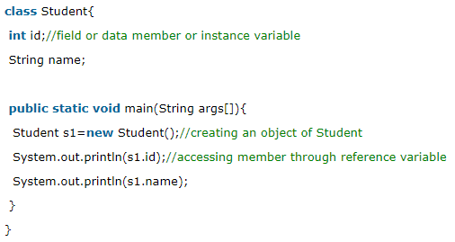
Examples
Object and Class Example: main within class:

Slide 8
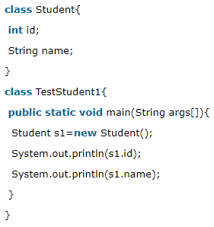
Examples
b) Object and Class Example: main outside class:
In real time development, we create classes and use it from another class. We can have multiple classes in different java files or single java file. If we define multiple classes in a single java source file, it is a good idea to save the file name with the class name which has main() method.

Slide 9
Variable types
There are several kinds of variables:
Member variables in a class—these are called fields.
Variables in a method or block of code—these are called local variables.
Variables in method declarations—these are called parameters.

Slide 10
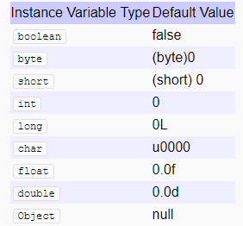
Instance variables
Instance variables are used by objects to store their states. Variables which are defined without the STATIC keyword and are Outside any method declaration are Object specific and are known as instance variables.
They are called so because their values are instance specific and are not shared among instances.
Instance variable will get default value means instance variable
can be used without initializing it. Same is not true for
Local Variable.

Slide 11
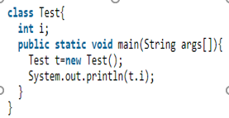
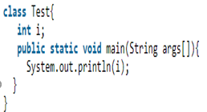
Example

Slide 12
static keyword in java
The static keyword in java is used for memory management mainly. We can apply java static keyword with variables, methods, blocks and nested class. The static keyword belongs to the class than instance of the class. The static can be:
variable (also known as class variable)
method (also known as class method)
block
nested class
Java static variable
The static variable can be used to refer the common property of all objects (that is not unique for each object) e.g. company name of employees, college name of students etc.
The static variable gets memory only once in class area at the time of class loading.

Slide 13
static variable
Advantage of static variable
It makes your program memory efficient (i.e it saves memory).
Java static method
If you apply static keyword with any method, it is known as static method.
A static method belongs to the class rather than object of a class.
A static method can be invoked without the need for creating an instance of a class.
static method can access static data member and can change the value of it.

Slide 14
static method
The static method can not use non static data member or call non-static method directly.
this and super cannot be used in static context.

Slide 15
Local variables
Variables that are declared inside Methods in a Java program are called local variables.
Rules for Local Variable
Local variables cannot use any of the access level since its scope is only inside the method.
Final is the Only Non-access modifier that can be applied to a local variable.
Local variables are not assigned a default value, hence they must be initialized before use.

Slide 16
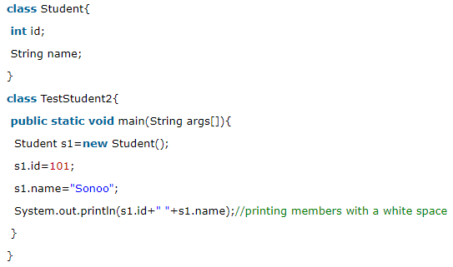
3 Ways to initialize object
Initialization through reference
Initializing object simply means storing data into object. Let's see a simple example where we are going to initialize object through reference variable.

Slide 17
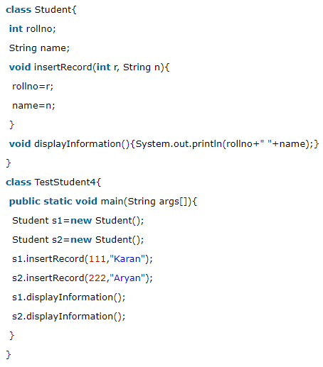
3 Ways to initialize object
B) Initialization through method
we are creating the two objects of Student class and initializing the value to these objects by invoking the insertRecord method. Here, we are displaying the state (data) of the objects by invoking the displayInformation() method.

Slide 18
Constructor
c) Initialization through constructor
Constructor in java is a special type of method that is used to initialize the object.
Java constructor is invoked at the time of object creation. It constructs the values i.e. provides data for the object that is why it is known as constructor
Rules for writing constructors
a) The name of the class and name of the constructor must be same:
b) A constructor may have or may not have parameters . Parameters are variables to receive data from outside into the constructor. If a constructor doesn’t have any parameters, it is called ‘default‘ constructor. If a constructor has 1 or more parameters, It is called “Parameterized constructor“.

Slide 19
Constructor
A constructor is called and executed only once per object
Default constructor
If we are not writing any constructor then the compiler always generate constructor
If we are writing at least one constructor then the compiler won’t generate any default constructor
Prototype of default constructor:
It is always no-arg constructor
It contains only one line i.e super(). It is a call to super class constructor and it should be no-arg call.

Slide 20
Prototype of default constructor
It is always no-arg constructor
It contains only one line i.e super().It is a call to super class constructor and it should be no-arg call.
The access modifier of the default constructor is same as class modifier(either public (or) default)
Note:
The first line inside any constructor should a call to super class Constructor.
If we are not writing any thing then the compiler will always place super().
We are not allowed to call super() (or) this() in a Constructor any where except first line. Other wise compile time error.
We can’t use super() or this() any where except in constructors, Otherwise we will get compile time error.

Slide 21
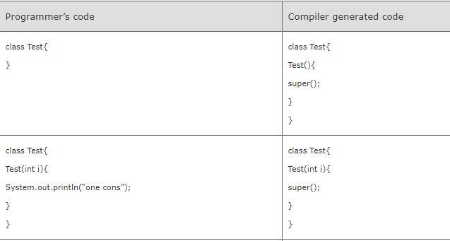
Constructor

Slide 22
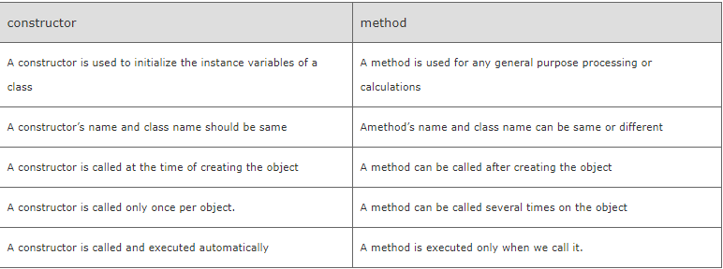
Method vs Constructor

Slide 23
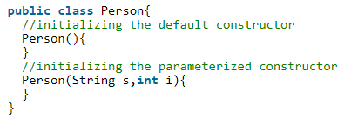

Constructor
Return type is not allowed for the constructors even void also
If we are placing the return type then compiler treats as a method. We wont get any compile time error.
A constructor is automatically called and executed at the time of creating an object.
If nothing is passed to the object, then default constructor is called and executed. if some values are passed to the object ,then the parameterized constructor is called
A constructor is called and executed only once per object

Slide 24
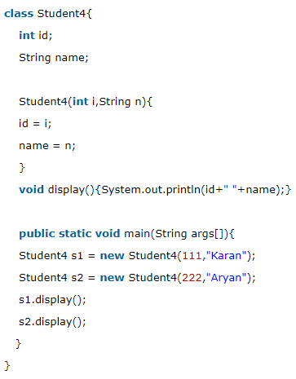
Constructor
Initialization through constructor
we have created the constructor of Student class that have two parameters. We can have any number of parameters in the constructor.

Slide 25
Using this Keyword
Within an instance method or a constructor, this is a reference to the current object — the object whose method or constructor is being called. You can refer to any member of the current object from within an instance method or a constructor by using this.
Using this with a Field
The most common reason for using this keyword is because a field is shadowed by a method or constructor parameter.

Slide 26
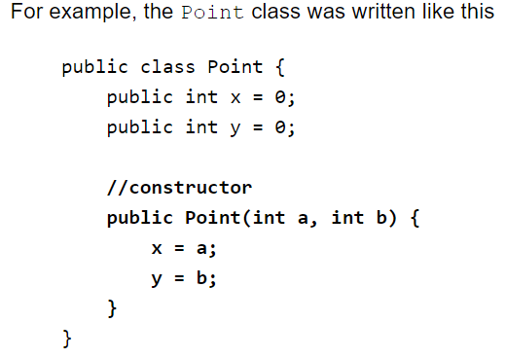
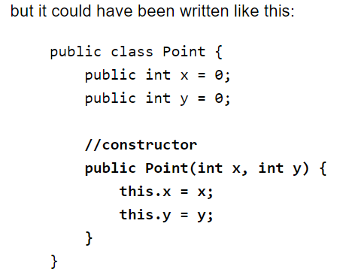
Example

Slide 27
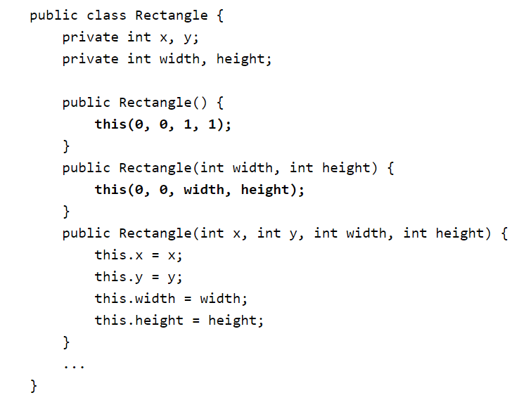
Using this with a Constructor

